Slide 1
Breaking Habits
January 2, 2019
Coach Shelby

Slide 2
Agenda
What causes bad habits?
Identifying triggers
How to break a bad habit and create a new one

Slide 3
What causes bad habits?
The Habit Loop:
Cue/Trigger
Routine/Action
Reward
http://www.hustlehealthy.com/habit-loop-to-control-life/

Slide 4
What causes a bad habit?
NOT lack of willpower
Stress
Boredom

Slide 5
Breaking bad habits
Create a new habit loop
How?
Identify triggers
Where are you?
Who are you with?
How do you feel?
What just happened?
What time is it?

Slide 6
Breaking bad habits
Eliminate/Replace triggers
What can we change?
What can’t we change?
Ask for help
Surround yourself with positive influences

Slide 7
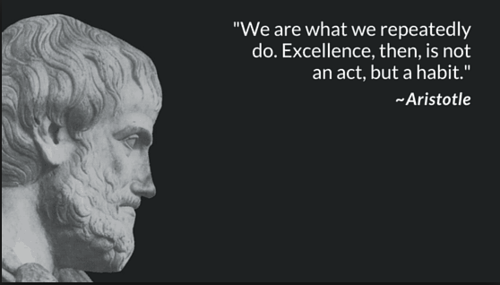
Breaking bad habits
Visualize yourself succeeding
Positive self-talk
“but”
Plan for failure
Progress vs. perfection

Slide 8
Breaking bad habits
Gratitude
Gratitude journal
Compassion
Write your “future self” a letter
Pride
Acknowledge your successes
https://www.bakadesuyo.com/2018/09/how-to-quit-bad-habits/

Slide 9
Action items
Identify your cues/triggers
Eliminate/replace
Ask for support
Visualize your success
Small changes!
Stress management!
*Bonus worksheet on the blog
http://www.hustlehealthy.com/habit-loop-to-control-life/

Slide 10
UPCOMING WEBINARS
Heart Health
Hot Topics
February is the month of love, and heart health month. Get tips on keeping your heart strong so you can keep on loving life for a long time to come!
We want to hear from you! What recent health trends or exercises are you wondering about? Get answers on navigating all the health information out there and the best ways for you to stay healthy.
February 6, 2019
March 6, 2019
Find out more on www.healthcheck360.com/blog

Slide 11
Contact us
www.twitter.com/healthcheck360
www.facebook.com/healthcheck360
www.healthcheck360.com/blog
www.instagram.com/healthcheck360/
@HealthCheck360 or #HealthCheck360
WATCH PAST WEBINARS
www.healthcheck360.com/blog
CONTACT A HEALTH COACH
1-866-511-0360 or healthcoach@healthcheck360.com

Slide 12
QUESTIONS?

