Slide 1
Maximize Your Workout
Presented By | HealthCheck360

Slide 2
Agenda
Efficient exercise ideas
Myths about exercise and time
Bonus workout!
Notes:
To Change a Picture
Right click on the picture you want to change, click “change picture,” then “from a file.”
O:\Wholesale Sales & Marketing\1. HealthCheck360\8. Templates\PowerPoint\Photos for PowerPoint

Slide 3
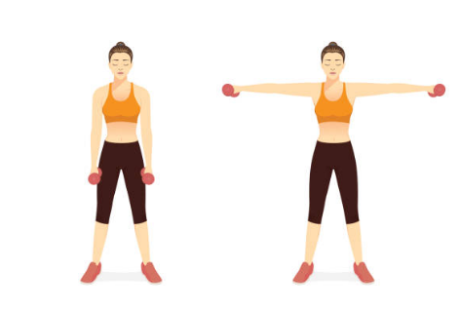
Efficient Exercise Tips
Circuit Training
Alphabet Method
J = Jumping Jacks
A = Air Squats
M = Mountain Climbers
I = Push ups
High Intensity Interval Training (HIIT)
Tabata
AMRAP – As Many Rounds as Possible
Lateral Raise
Get active!
Notes:
To Change a Picture
Right click on the picture you want to change, click “change picture,” then “from a file.”
O:\Wholesale Sales & Marketing\1. HealthCheck360\8. Templates\PowerPoint\Photos for PowerPoint

Slide 4
HC360 workout
H – High Knees (30 seconds)
E – Elbow Plank (30 seconds)
A – Alternating Lunges (10 each side)
L – Lateral Raises (12 repetitions)
T – Triceps Dips (12 repetitions)
H –High Knees (30 seconds)
C – Crunches (20 repetitions)
H – High Knees (30 seconds)
E –Elbow Planks (30 seconds)
C – Crunches (20 repetitions)
K – Knee Tucks (Seated or Lying) (15 repetitions)
Beginner: 1 round
Intermediate: 2–3 rounds
Advanced: 4+ rounds
**Rest 30–60 seconds between exercises and 1–2 minutes between rounds.
Notes:
To Change a Picture
Right click on the picture you want to change, click “change picture,” then “from a file.”
O:\Wholesale Sales & Marketing\1. HealthCheck360\8. Templates\PowerPoint\Photos for PowerPoint

Slide 5
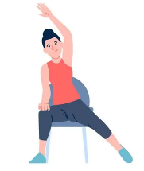
Efficient Exercise Tips
Workout Split
Lower body
Upper body
Full body
Cardio
Compound Movements
Squat
Overhead press
Side bend
Get active!
Notes:
To Change a Picture
Right click on the picture you want to change, click “change picture,” then “from a file.”
O:\Wholesale Sales & Marketing\1. HealthCheck360\8. Templates\PowerPoint\Photos for PowerPoint

Slide 6
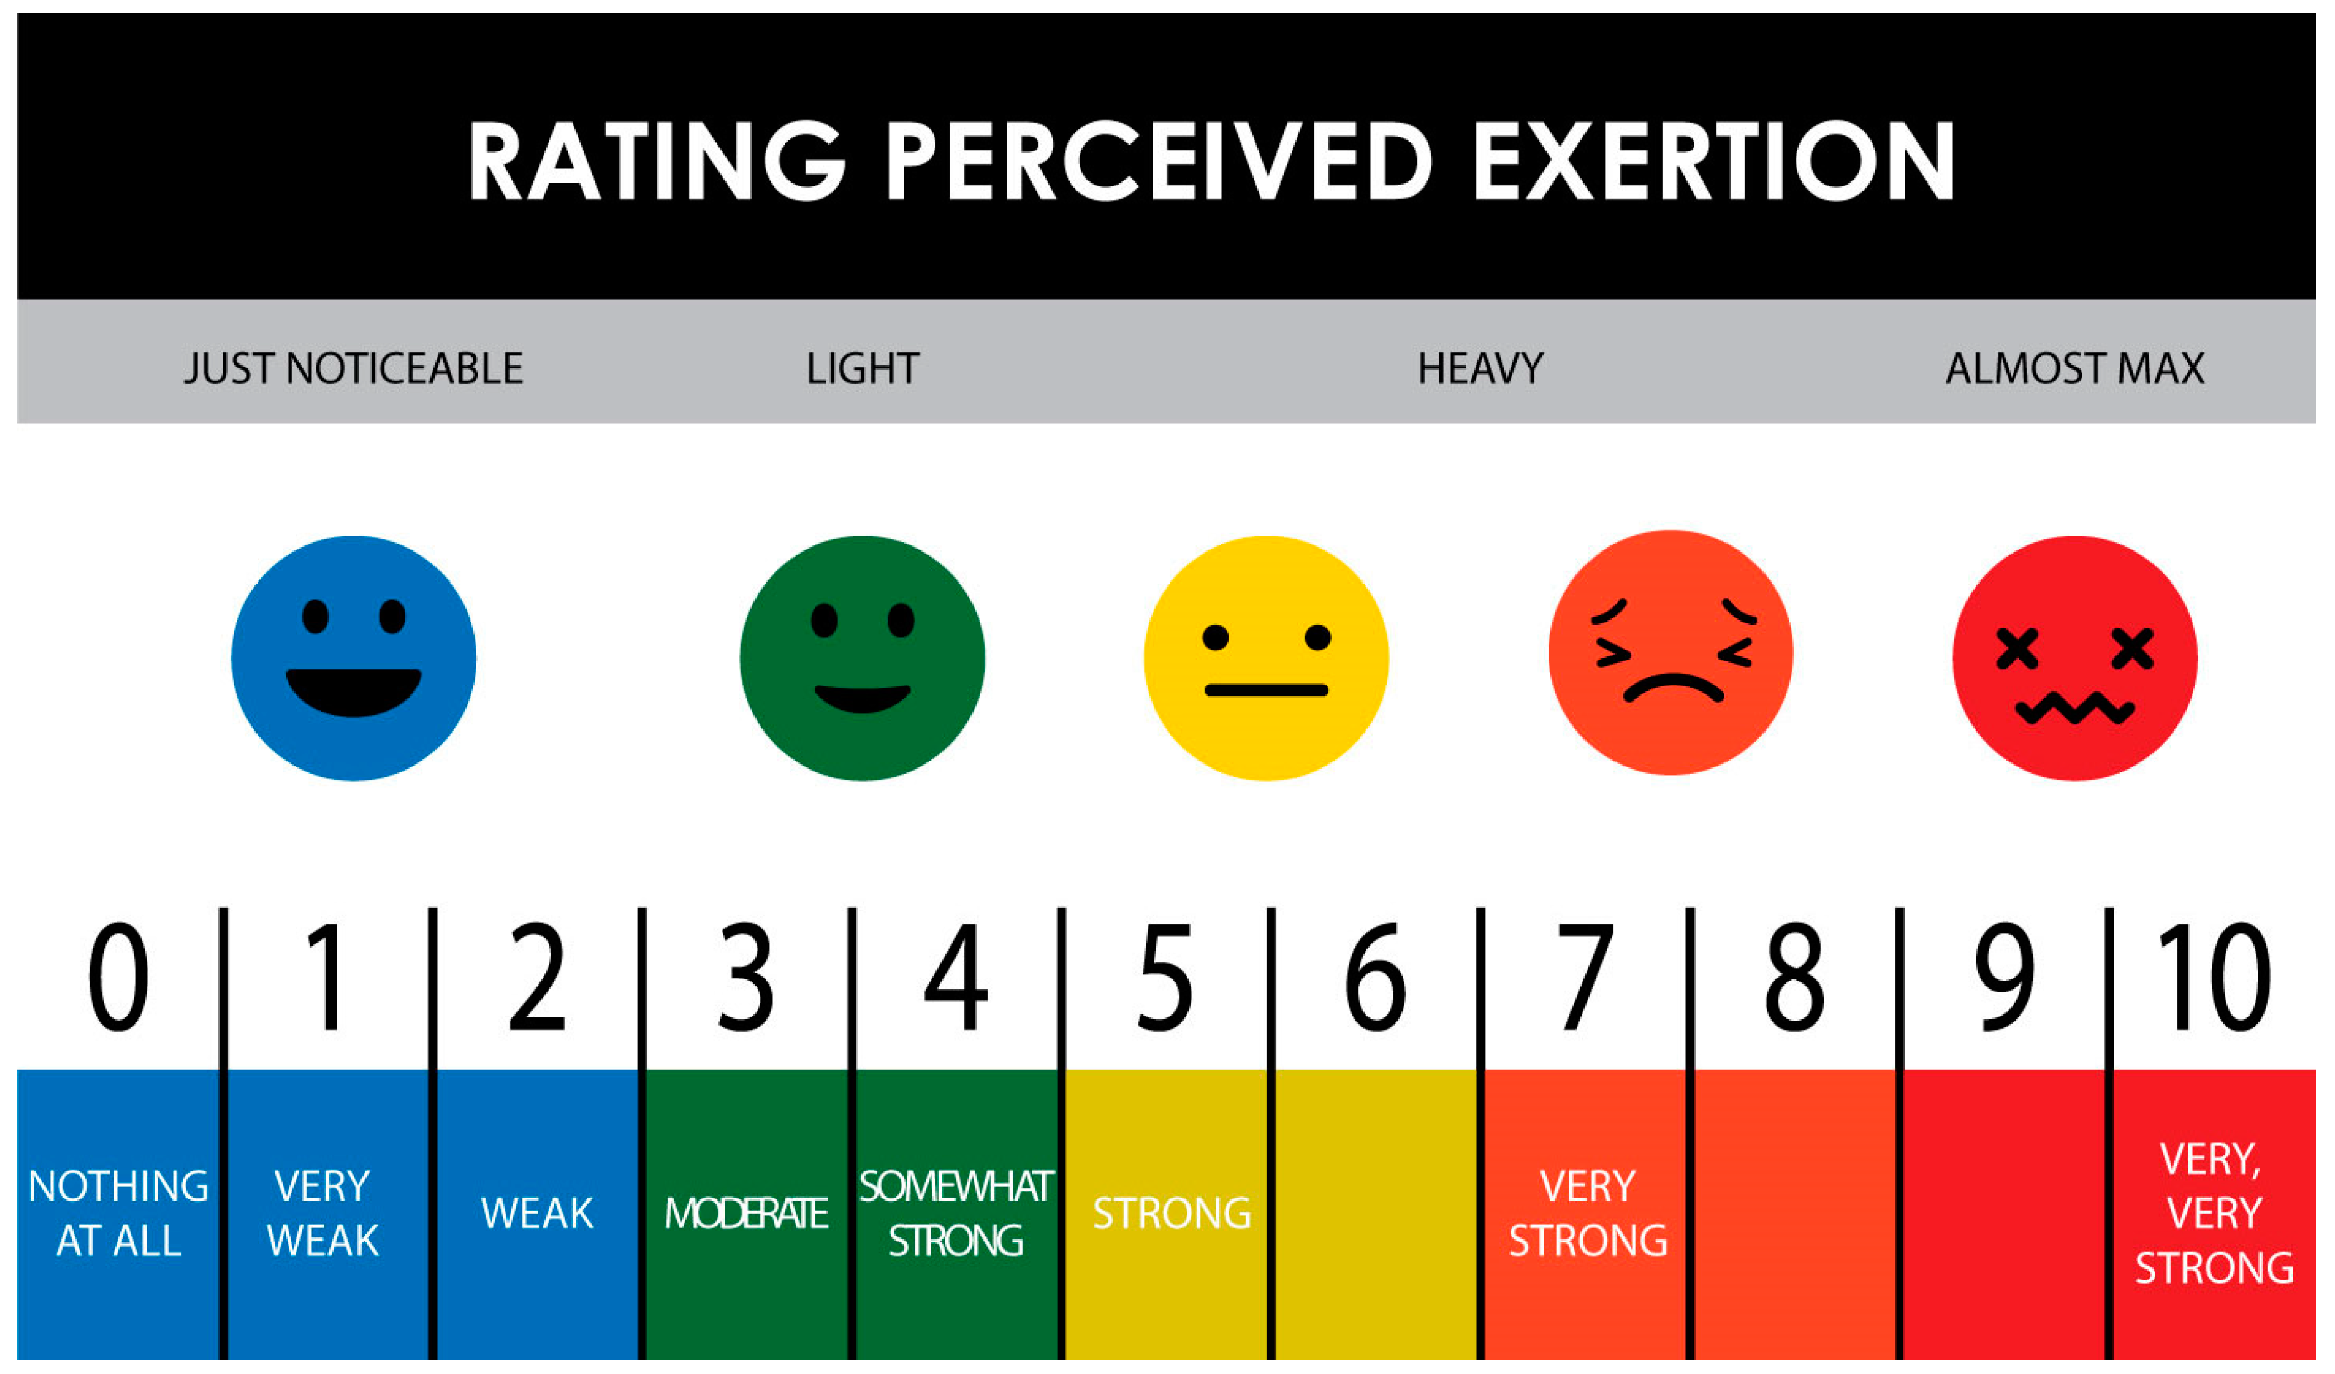
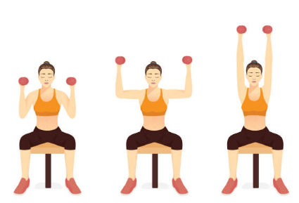
Efficient Exercise Tips
RPE and Talk Test
Overhead press
Get active!
https://www.mdpi.com/sports/sports-07-00161/article_deploy/html/images/sports-07-00161-g002.png
Notes:
To Change a Picture
Right click on the picture you want to change, click “change picture,” then “from a file.”
O:\Wholesale Sales & Marketing\1. HealthCheck360\8. Templates\PowerPoint\Photos for PowerPoint

Slide 7
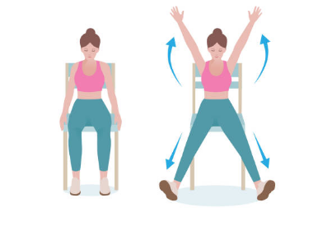
Myths
How much time should exercise take?
Identify how much time you have
Are you a segmenter or an integrator?
Are you sabotaging yourself?
I “only” have 10 minutes
Step goals
Realistic goal
Find opportunities
How do I increase intensity?
Intervals
Pace
Get active!
Seated jack
https://www.thehrdigest.com/4-rules-of-work-life-balance-and-why-youve-been-getting-it-wrong/
Notes:
To Change a Picture
Right click on the picture you want to change, click “change picture,” then “from a file.”
O:\Wholesale Sales & Marketing\1. HealthCheck360\8. Templates\PowerPoint\Photos for PowerPoint

Slide 8
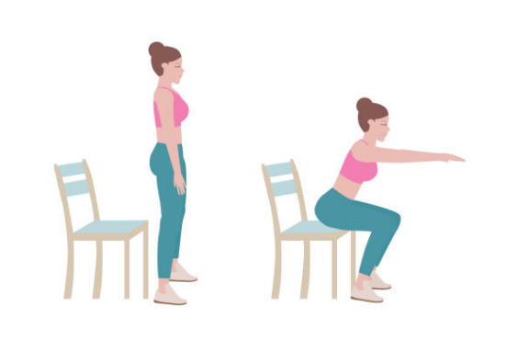
Myths
I need a gym membership to exercise
Bodyweight exercises
Increase intensity
Equipment for home
Dumbbells
Resistance bands
Chair squat
Get active!
Notes:
To Change a Picture
Right click on the picture you want to change, click “change picture,” then “from a file.”
O:\Wholesale Sales & Marketing\1. HealthCheck360\8. Templates\PowerPoint\Photos for PowerPoint

Slide 9
Summary
Invest what you can in your physical fitness
Make the most of the time you have
Notes:
To Change a Picture
Right click on the picture you want to change, click “change picture,” then “from a file.”
O:\Wholesale Sales & Marketing\1. HealthCheck360\8. Templates\PowerPoint\Photos for PowerPoint

Slide 10
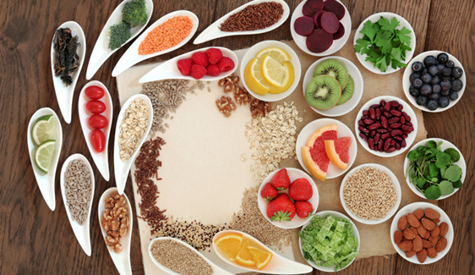
Upcoming Webinars
The Science of Breathwork
What is Intuitive Eating?
Discover how breathing exercises can improve your health in unexpected ways. From stress response and sleep quality to pain management, learn how to tap into the power of breathwork anytime, anywhere.
August 6
Explore the power of intuitive eating and find out how this practice can improve your nutrition. Learn how to honor your hunger and finally make peace with food.
September 3

Slide 11
Lifestyle Rewards
True or False: If you don’t have time to exercise for an hour, don’t bother
True
False
What was one example of circuit training mentioned?
Alphabet method
Mountain climbers
What is it called when you increase your speed for specific amount of time during a walk and then slow back down?
Bodyweight exercise
Intervals
* If your company has elected questions for lifestyle rewards, it will be noted when you submit on your account.
Notes:
To Change a Picture
Right click on the picture you want to change, click “change picture,” then “from a file.”
O:\Wholesale Sales & Marketing\1. HealthCheck360\8. Templates\PowerPoint\Photos for PowerPoint
To Change an Icon: Go to “Insert” in the top menu, click icons, then select the icon you wish to include. You can update the color under the “Shape Format” tab.

Slide 12
Get in Touch
Social Media
www.facebook.com/healthcheck360
www.healthcheck360.com/blog
www.instagram.com/healthcheck360/
@HealthCheck360 or #HealthCheck360
Watch past webinars and register for upcoming
www.healthcheck360.com/blog
Contact a Health Coach
1-866-511-0360 or healthcoach@healthcheck360.com
Notes:
To Change a Picture
Right click on the picture you want to change, click “change picture,” then “from a file.”

Slide 13
Questions?
Notes:
To Change a Picture
Right click on the picture you want to change, click “change picture,” then “from a file.”
O:\Wholesale Sales & Marketing\1. HealthCheck360\8. Templates\PowerPoint\Photos for PowerPoint

