Slide 1

AI for Health
Presented By | HealthCheck360

Slide 2

Agenda
What AI is and what it is not
How AI can support your health
Tips and considerations
Notes:
To Change a Picture
Right click on the picture you want to change, click “change picture,” then “from a file.”
O:\Wholesale Sales & Marketing\1. HealthCheck360\8. Templates\PowerPoint\Photos for PowerPoint

Slide 3

What is AI?
Artificial intelligence is the theory and development of computer systems capable of performing tasks that historically required human intelligence, such as recognizing speech, making decisions, and identifying patterns.
Traditional
Generative
https://www.coursera.org/articles/what-is-artificial-intelligence?msockid=259e148150dc67081fce026f51466615
Notes:
To Change a Picture
Right click on the picture you want to change, click “change picture,” then “from a file.”
O:\Wholesale Sales & Marketing\1. HealthCheck360\8. Templates\PowerPoint\Photos for PowerPoint

Slide 4

What is AI?
What AI is:
A thought partner
  Brainstorming
  Goal-setting
    SMART goals
  Identifying patterns
  Reminders and accountability
What AI is NOT:
A medical professional who can diagnose or prescribe
100% correct
An expert in your circumstances
Private
Notes:
To Change a Picture
Right click on the picture you want to change, click “change picture,” then “from a file.”
O:\Wholesale Sales & Marketing\1. HealthCheck360\8. Templates\PowerPoint\Photos for PowerPoint

Slide 5
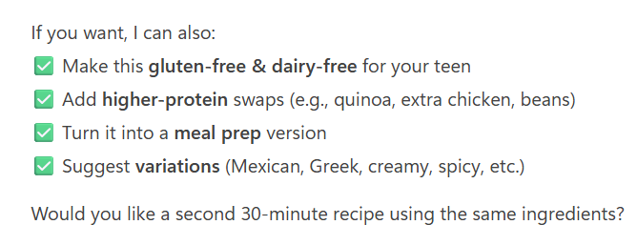
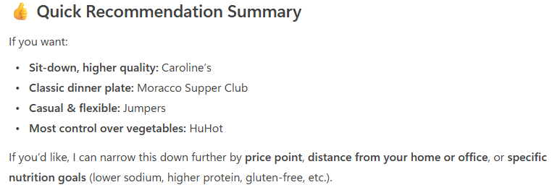
How AI Can Support your Health
Nutrition
Food suggestions
Recipes
  Diet preferences
  Allergies or intolerances
Meal planning
  Grocery lists
Restaurant selections
Notes:
To Change a Picture
Right click on the picture you want to change, click “change picture,” then “from a file.”
O:\Wholesale Sales & Marketing\1. HealthCheck360\8. Templates\PowerPoint\Photos for PowerPoint

Slide 6
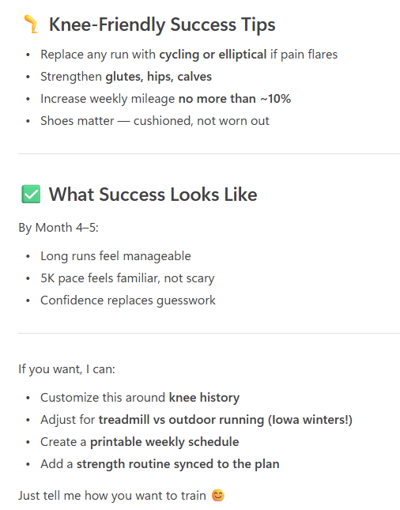
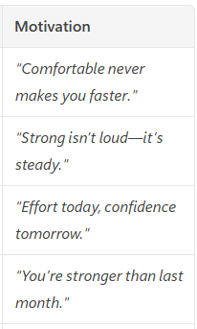
How AI Can Support your Health
Exercise
Exercise and workout ideas
  Goals
  Equipment
  Limitations
  Time
  Fitness level
  Preferences
Program design
  Create a program based on
  your goals
  Track progress
  Reminders and motivation
Notes:
To Change a Picture
Right click on the picture you want to change, click “change picture,” then “from a file.”
O:\Wholesale Sales & Marketing\1. HealthCheck360\8. Templates\PowerPoint\Photos for PowerPoint

Slide 7

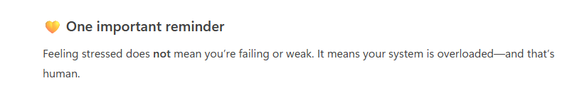
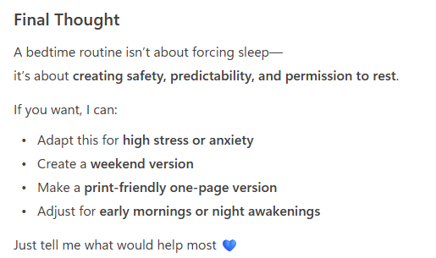
How AI Can Support your Health
Stress management and brain health
Journaling
Tracking
In the moment tips
Sleep
Tracking
Sleep hygiene tips
Notes:
To Change a Picture
Right click on the picture you want to change, click “change picture,” then “from a file.”
O:\Wholesale Sales & Marketing\1. HealthCheck360\8. Templates\PowerPoint\Photos for PowerPoint

Slide 8

How AI Can Support your Health
Tips on prompting
Be specific, clear, and detailed
Provide context
Refine and adjust as needed
Limitations of AI
Privacy concerns
Wrong or outdated information
  Hallucinations
Personal context
Misinterpretation, bias, and oversimplification
Environmental impact
Overreliance
https://www.ibm.com/think/topics/ai-hallucinations
Notes:
To Change a Picture
Right click on the picture you want to change, click “change picture,” then “from a file.”
O:\Wholesale Sales & Marketing\1. HealthCheck360\8. Templates\PowerPoint\Photos for PowerPoint

Slide 9

Summary
AI is a tool that can help support you in your health journey
It is not a decision-maker
Use it wisely
Notes:
To Change a Picture
Right click on the picture you want to change, click “change picture,” then “from a file.”
O:\Wholesale Sales & Marketing\1. HealthCheck360\8. Templates\PowerPoint\Photos for PowerPoint

Slide 10

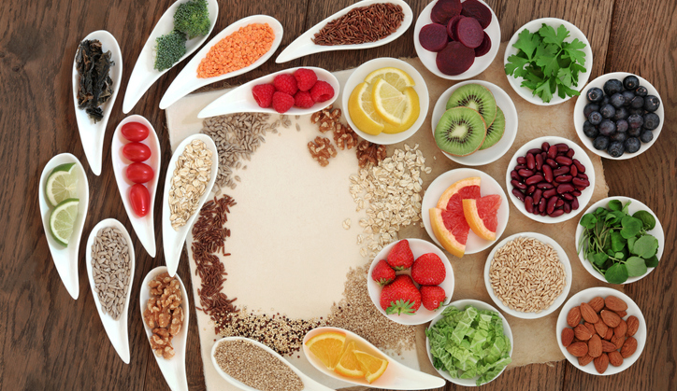
Upcoming Webinars
The 5 Cs of Mental Health
Seasonal Eating
Explore the 5 Cs of building a stronger foundation for mental well-being and brain health: Control, Confidence/Competence, Coping, Compassion, and Connection.
May 6
Discover the benefits of eating with the seasons. Learn how fresh fruits and veggies can energize your body and support sustainable habits.
June 3

Slide 11
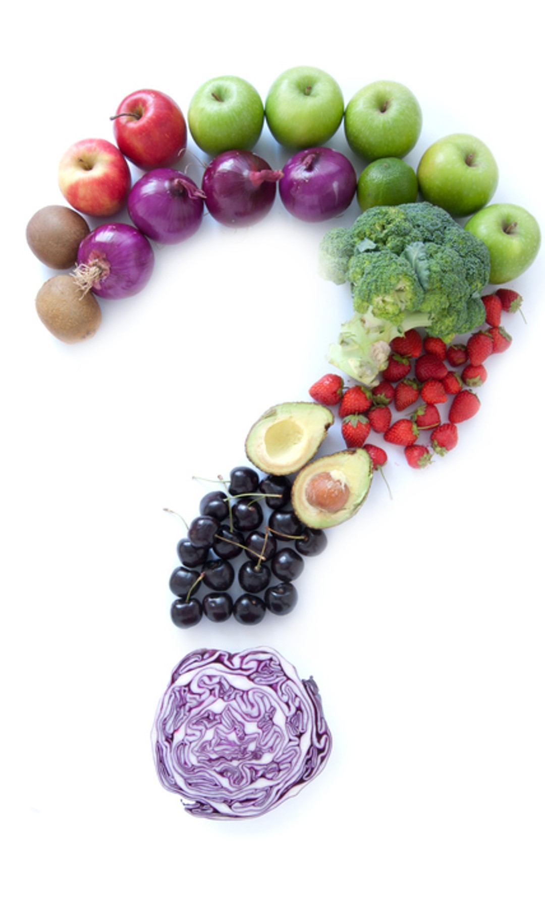
Lifestyle Rewards
True or False: AI is 100% correct all the time.
  True
  False
What is one tip for prompting in AI?
  Add context for your personal situation
  Be vague
What is one limitation of AI?
  Too private
  Outdated data
* If your company has elected questions for lifestyle rewards, it will be noted when you submit on your account.
Notes:
To Change a Picture
Right click on the picture you want to change, click “change picture,” then “from a file.”
O:\Wholesale Sales & Marketing\1. HealthCheck360\8. Templates\PowerPoint\Photos for PowerPoint
To Change an Icon: Go to “Insert” in the top menu, click icons, then select the icon you wish to include. You can update the color under the “Shape Format” tab.

Slide 12

Get in Touch
Social Media
www.facebook.com/healthcheck360
www.instagram.com/healthcheck360/
Watch past webinars and register for upcoming
www.healthcheck360.com/blog
Contact a Health Coach
1-866-511-0360 or healthcoach@healthcheck360.com
Notes:
To Change a Picture
Right click on the picture you want to change, click “change picture,” then “from a file.”

Slide 13

Questions?
Notes:
To Change a Picture
Right click on the picture you want to change, click “change picture,” then “from a file.”
O:\Wholesale Sales & Marketing\1. HealthCheck360\8. Templates\PowerPoint\Photos for PowerPoint

