Slide 1
Our Team Results [Presentation for department leaders to share feedback with their team]
September 21, 2023
Notes:
This deck includes many slides from which you can pick and choose what to share with your team and when. Do not feel like you must cover every slide.
Feel free to log into myengage360.com and walk your team through the results within the portal directly. This will also reinforce the anonymity of the feedback coming into the system.
Also, you can download a CSV files for any charts/data captured by the Engage360 system to create your own charts and graphs.

Slide 2
Section 1:
Share with Employees
Notes:
The slides in section one are intended to be shared with all employees on your team.

Slide 3
Our Commitment to our People
Our leadership team will be regularly working together to:
Learn from the feedback provided
Share the results with the team
Partner with team members on any changes or initiatives that may address the feedback received
  Insert specific language important to you and your company.
Simply download charts from manager portal (myengage360.com) and paste above.
Go to Home page to view chart.
Also, feel free to share the reporting dashboard live with your team!
Notes:
Our leadership team will be regularly working together to learn from the feedback provided, share the results, and partner with you on any changes or initiatives that may happen to address the feedback received.

Slide 4
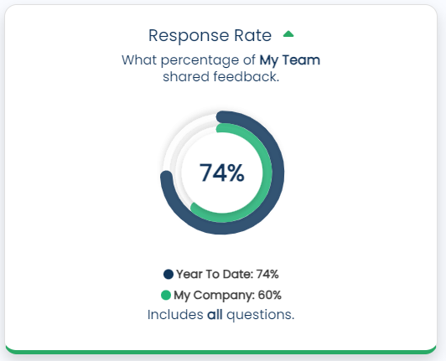
Our Department’s Response Rate
Date Range: XX/ XX/XXXX – XX/XX/XXXX
Communication tool to improve your experience at work.
  In seconds share what’s on you mind
  Text message option available
Feedback is 100% anonymous!
  There is no way to see the identity of who is providing feedback
Leadership cares and wants to identify needs and areas for improvement.
  Stay on top of evolving needs
  Better understand the team’s experience
  Insert WHY survey response is specifically important to you and your company.
Simply download charts from manager portal (myengage360.com) and paste above.
Go to Home page to view chart.
Also, feel free to share the reporting dashboard live with your team!
Notes:
Share why survey response is important to you and the company.
Example Script:
Our team’s response rate year to date is 74%. Overall company average is 60% year to date for all of [insert your company name].
Our team’s response rate has improved and is well over the company’s average. Keep it up! Remember I don’t know who responses or how they respond. What’s important is feedback is coming in from everyone on the team, so leadership gets a full picture of what matters to employees. We want to continuously get better and be a workplace of choice for others, as we grow our business, and most importantly a place you all can be proud to be a part of! Thank you for your continued participation and sharing your thoughts and onions.

Slide 5
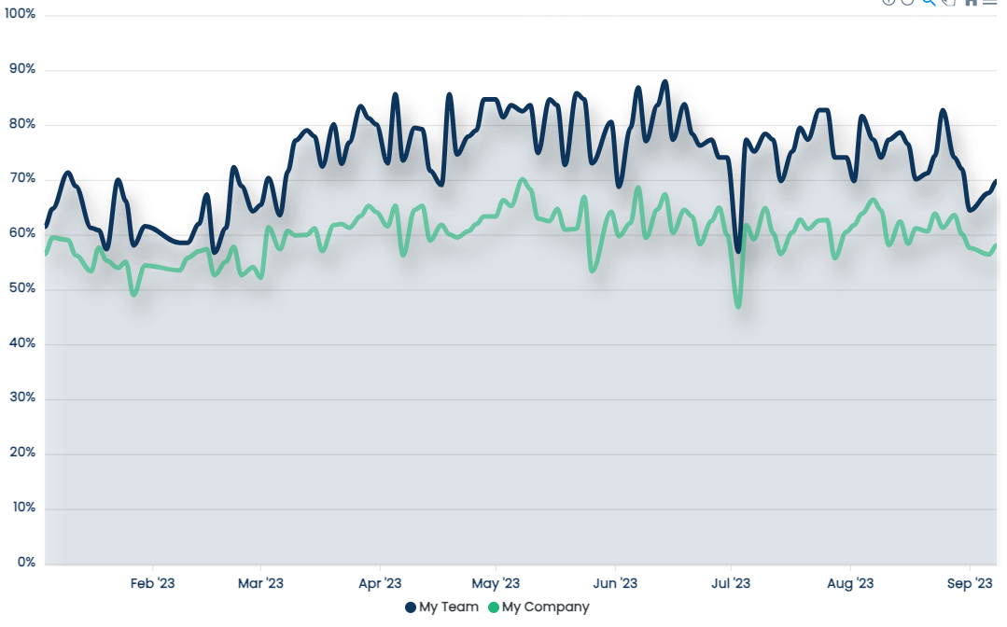
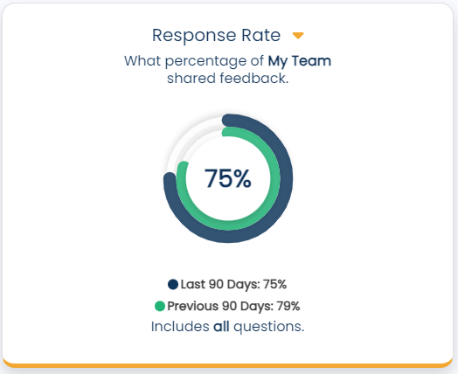
Our Department’s Response Rate Trend
Date Range: XX/ XX/XXXX – XX/XX/XXXX
  Since our last update (90 days ago) we are running at 75%.
Our Goal – X%
  Highest Rate – X%
  Lowest Rate – X%
Simply download charts from manager portal (myengage360.com) and paste above.
Go to Reports and Trends to view chart.
OR click on the Response Rate circle on Home page.
Also, feel free to share the reporting dashboard live with your team!
Notes:
Example Script for Participation Rate: Since our last update (90 days ago) we are running at 75%. Our goal is X%...
Remember to…
1. Set an initial response rate goal:
Recommend a minimum of X% response rate with a push goal of X%
Engage360 does see individual teams consistently achieve 100%!
2. Encourage maintenance of a high response rate goal:
Acknowledge your team’s great participation

Slide 6
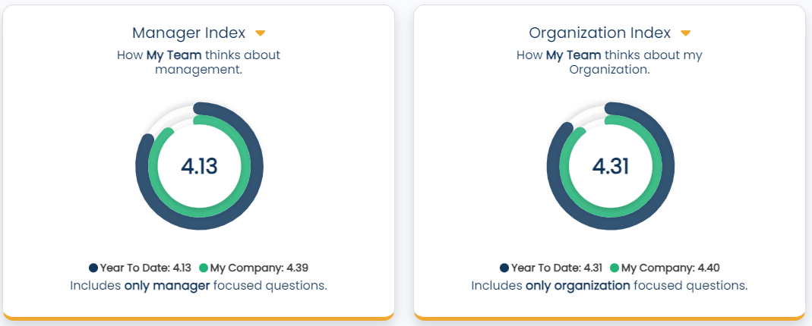
Our Department’s Engagement Scores
Date Range: XX/ XX/XXXX – XX/XX/XXXX
Summary
  Manager Index: 4.13
  Organization Index: 4.31
  Highlights:
    [insert comment]
    [insert comment]
Simply download charts from manager portal (myengage360.com) and paste above.
Go to Home page to view charts.
Also, feel free to share the reporting dashboard live with your team!
Notes:
Example Script for Managers of Managers to Broader Team (Department/Division):
From a Manager Index perspective, our management team continues to be in line the company average at 0.00, with the overall company average being 0.00.
From an Organization Index perspective, our team's perception of the organization is aligned with that of our peers with an average of 0.00.

Slide 7
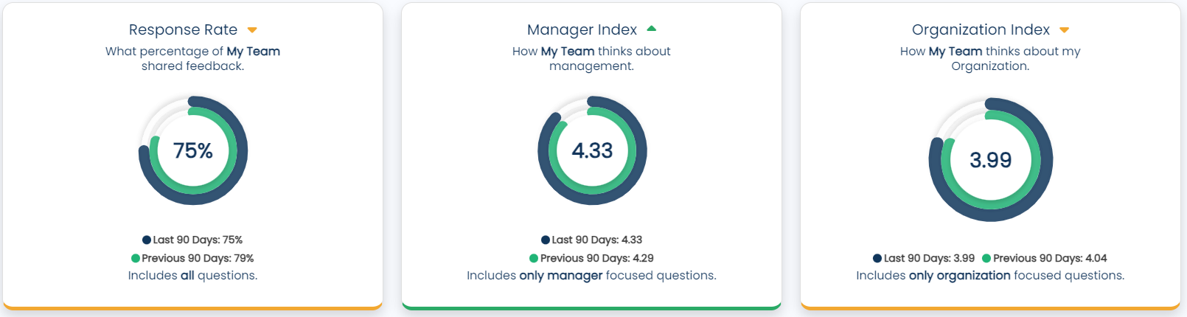
Our Department’s Progress [Compare time periods)
Timeframe: Last X Days/Months to Previous X Days/Months
Simply download charts from manager portal (myengage360.com) and paste above.
Go to Home page to view charts.
Use the Date Range and Compare To filters to compare timeframes.
Also, feel free to share the reporting dashboard live with your team!
Notes:
Example Script for Managers of Managers to Broader Team (Department/Division):
In comparing the last X days/months to the previous X days/months (last 90 days to the previous 90 days), we have slightly less participation.
From a Manager Index perspective, our management team continues to be slightly above the company average at 0.00, with the overall company average being 0.00.
From an Organization Index perspective, our team’s perception of the organization remains fairly consistent.

Slide 8
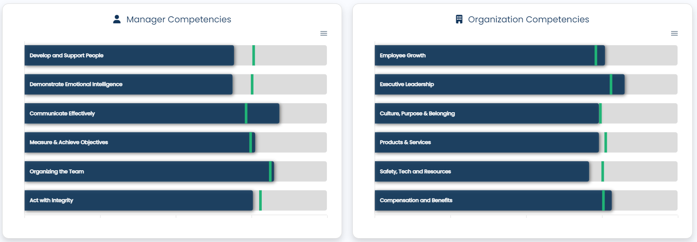
Our Department’s Average Score by Manager competencies
Date Range: XX/ XX/XXXX – XX/XX/XXXX
Summary
  Strongest Competencies:
    Communicate Effectively
    Measure & Achieve Objectives
  Areas of Opportunity:
    Develop and Support People
    Demonstrate Emotional Intelligence
Simply download charts from manager portal (myengage360.com) and paste above.
Go to Home page to view charts.
Also, feel free to share the reporting dashboard live with your team!
Notes:
Example Script for Managers of Managers to Broader Team (Department/Division):
From a Manager Index perspective, across the 6 main question categories, our management team is at or above the benchmark on X of 6.
Our management team will keep focusing on these categories while thinking about how I can improve in these other areas. I am always happy to listen and discuss any feedback you wish to share with me. Our team is my priority and it’s important to me that I continue to improve as a leader and develop our management team to better support you and together achieve greater organizational success.
We know you all create value for our customers, and we want to know how we as a management team can continue to support and develop you all, so you can support and grow our client base, while remaining happy working at [insert company name].

Slide 9
Our Department’s Average Score by Organization competencies
Date Range: XX/ XX/XXXX – XX/XX/XXXX
Summary
  Strongest Competencies :
    Executive Leadership
    Employee Growth
  Areas of Opportunity:
    Safety, Tech, and Resources
    Products and Services
Simply download charts from manager portal (myengage360.com) and paste above.
Go to Home page to view charts.
Also, feel free to share the reporting dashboard live with your team!
Notes:
Example Script for Managers of Managers to Broader Team (Department/Division):
From an Organization Index perspective, across the 6 main question categories, our team’s perception of the organization is at or above the benchmark on X of 6.
Example Script for Manager to Direct Reports:
From an Organization Index perspective, across the 6 main question categories, our team’s perception of the organization is at or above the benchmark on X of 6.
I will keep focus on these categories within leadership meetings to work towards improvements. I am always happy to listen and discuss any feedback you wish to share with me. What would you like me to share with the executive leadership team?

Slide 10
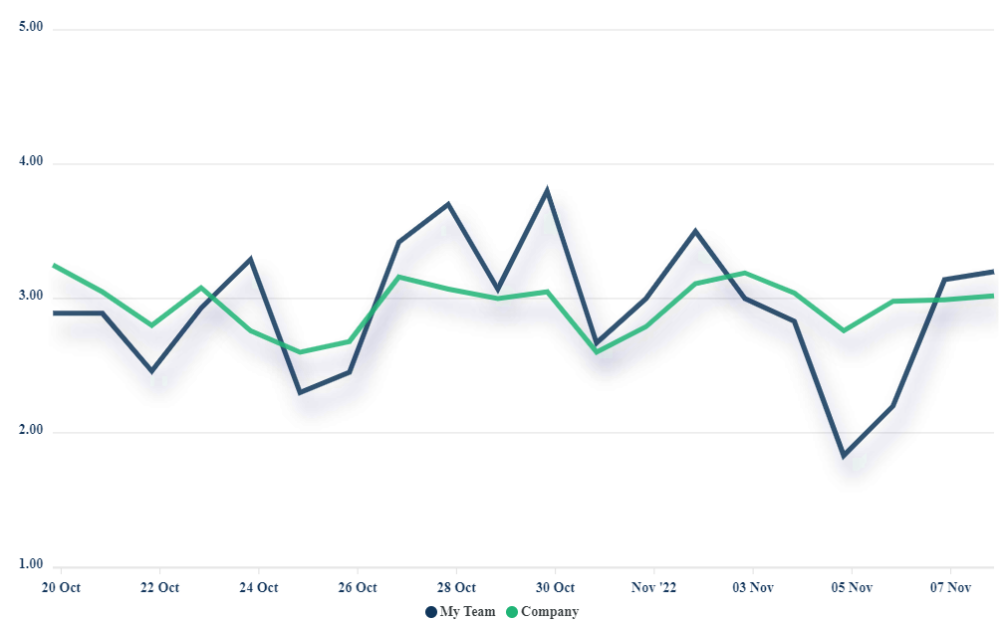
Our Department’s Score Trend for Manager Or Organization
Date Range: XX/ XX/XXXX – XX/XX/XXXX
Highlights
  Highest Score – 4.64 (December 29)
    Question: I'm proud of my work this year at Company ABC.
  Lowest Rate – 2.82 (November 11)
    Question: I have adequate time to manage my daily workload.
Simply download charts from manager portal (myengage360.com) and paste above.
Go to Reports and Trends to view chart.
OR click on the Manager/Organization Index circle on Home page.
Also, feel free to share the reporting dashboard live with your team!
Notes:
Reinforce something going great! Be open about something that needs work to improve.

Slide 11
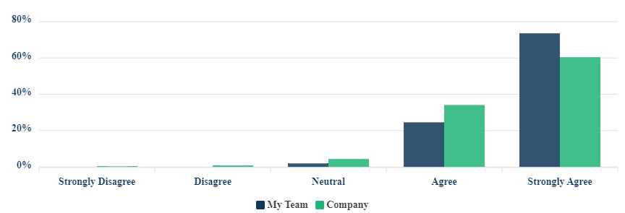
Our Department’s Highest Scoring Question
Date Range: XX/ XX/XXXX – XX/XX/XXXX
Summary
  Average: 4.68 out of 5
  Response Rate: 70.55%
  Category: Safety
  Date: XX/XX/XXXX
Overall, my workplace is safe.
Simply download chart from manager portal (myengage360.com) and paste above.
Go to Home page to view question charts.
Also, feel free to share the reporting dashboard live with your team!

Slide 12
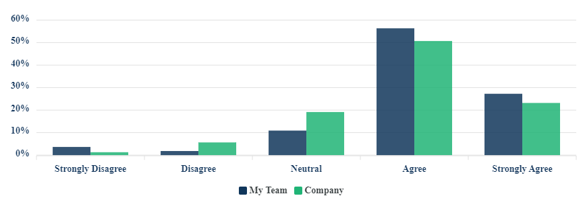
Our Department’s Lowest Scoring Question
Date Range: XX/ XX/XXXX – XX/XX/XXXX
Summary
  Average: 3.1 out of 5
  Response Rate: 54.4%
  Category: Resources
  Date: XX/XX/XXXX
I have the materials and equipment I need to do my job.
Simply download chart from manager portal (myengage360.com) and paste above.
Go to Home page to view question charts.
Also, feel free to share the reporting dashboard live with your team!

Slide 13
Our Department’s Spotlight Question
Date Range: XX/ XX/XXXX – XX/XX/XXXX
Summary
  Average: 3.83 out of 5
  Response Rate: 55.6%
  Category: Culture & Purpose
  Date: XX/XX/XXXX
I feel the work I do impacts the company positively.
Simply download chart from manager portal (myengage360.com) and paste above.
Go to Home page to view question charts.
Also, feel free to share the reporting dashboard live with your team!

Slide 14
Our Department’s Highest and Lowest Questions
Date Range: XX/ XX/XXXX – XX/XX/XXXX
Top Questions
  My manager creates a supportive and empathetic work environment. (4.64)
  Our executive leadership demonstrates effective decision making. (4.60)
  My manager communicates clearly and effectively. (4.58)
  The organization provides opportunities for employees to attend training sessions, conference, and other learning events. (4.46)
  Bottom Questions:
  I have the necessary technology and equipment to perform my job effectively (2.82)
  The organization promotes a culture of health and wellness. (3.20)
  My manager helps me identify skill gabs to focus my development. (3.46)
  My manager is willing to have hard conversations. (3.67)
Notes:
Add categories to these questions

Slide 15
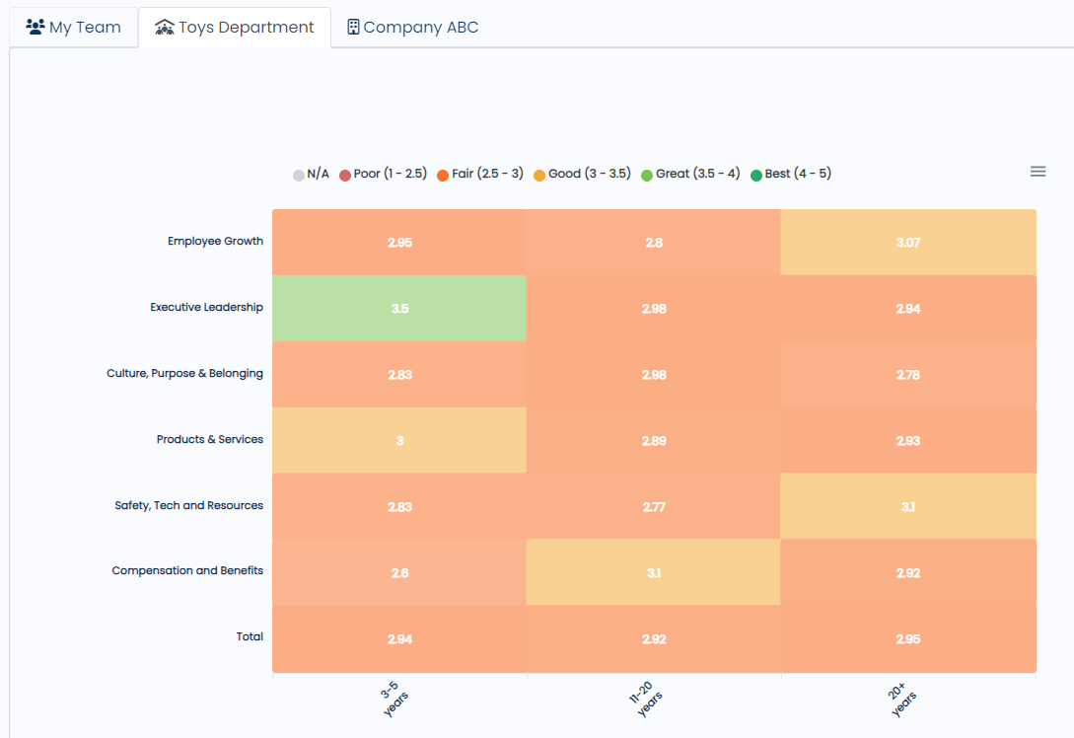
Our Department’s Organization Index by Tenure
Date Range: XX/ XX/XXXX – XX/XX/XXXX
Time Period: X months
Summary
  [insert comment]
View the Heat Map and select the attribute of choice (department, location, role, age, tenure, etc.).
Reminder: Engage360 will not display any demographic data that may indicate any response to a specific individual. If data does not appear, it is because the anonymity threshold was not met to protect small groupings of employees.

Slide 16
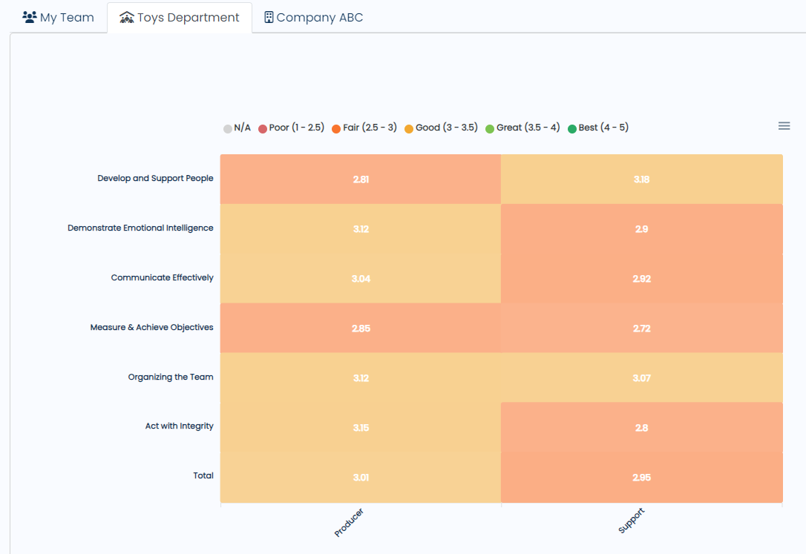
Our Department’s Manager Index by Role type
Date Range: XX/ XX/XXXX – XX/XX/XXXX
Time Period: X months
Summary
  [insert comment]
View the Heat Map and select the attribute of choice (department, location, role, age, tenure, etc.).
Reminder: Engage360 will not display any demographic data that may indicate any response to a specific individual. If data does not appear, it is because the anonymity threshold was not met to protect small groupings of employees.

Slide 17
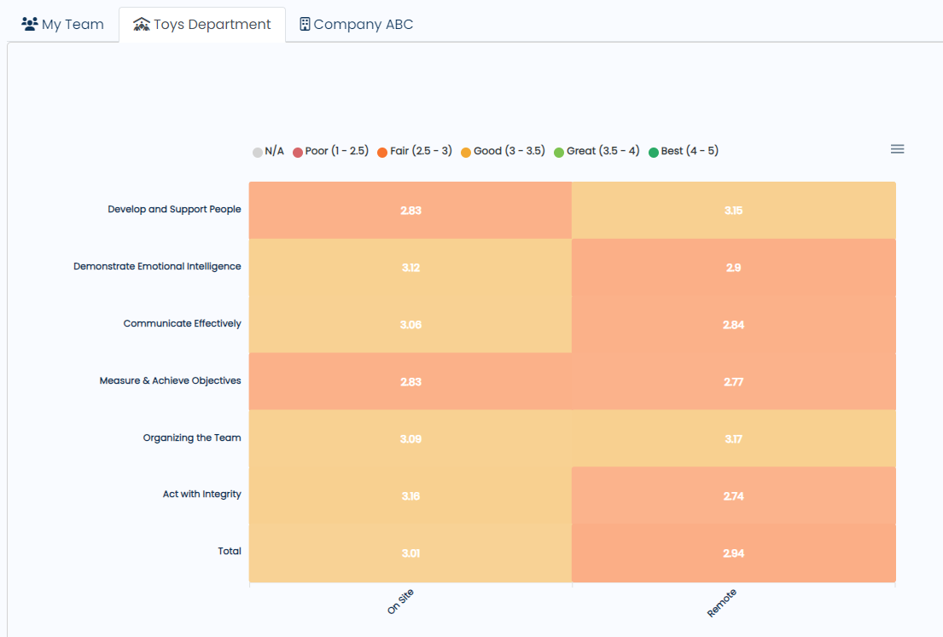
Our Department’s Manager Index by On-Site and Remove Employees
Date Range: XX/ XX/XXXX – XX/XX/XXXX
Time Period: X months
Summary
  [insert comment]
View the Heat Map and select the attribute of choice (department, location, role, age, tenure, etc.).
Reminder: Engage360 will not display any demographic data that may indicate any response to a specific individual. If data does not appear, it is because the anonymity threshold was not met to protect small groupings of employees.

Slide 18
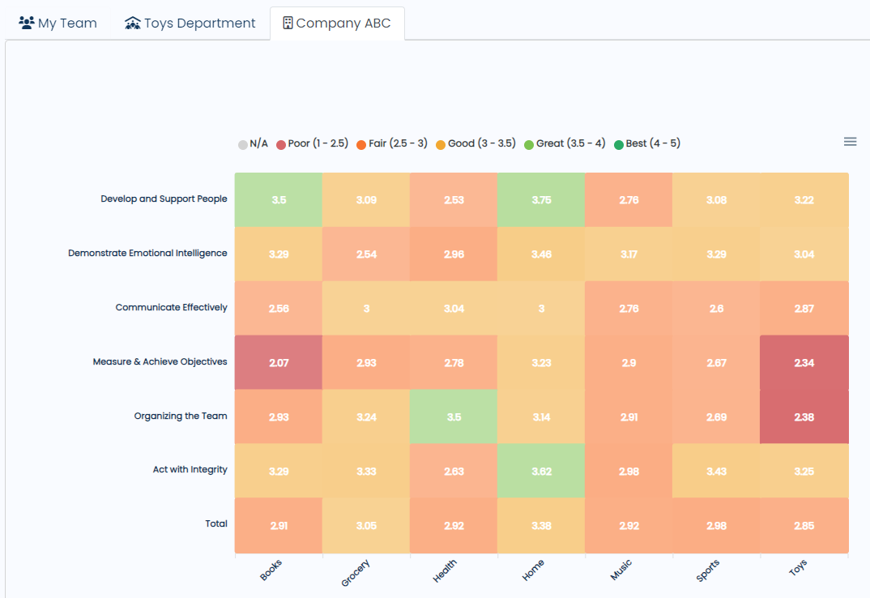

Manager Index by Department by Competencies
Date Range: XX/ XX/XXXX – XX/XX/XXXX
Time Period: X months
  Top Departments:
  Home
  Grocery
  What are these teams doing to achieve high engagement scores?
  Lagging Departments:
  Toys
  Books
View the Heat Map and select the attribute of choice (department, location, role, age, tenure, etc.).
Reminder: Engage360 will not display any demographic data that may indicate any response to a specific individual. If data does not appear, it is because the anonymity threshold was not met to protect small groupings of employees.

Slide 19
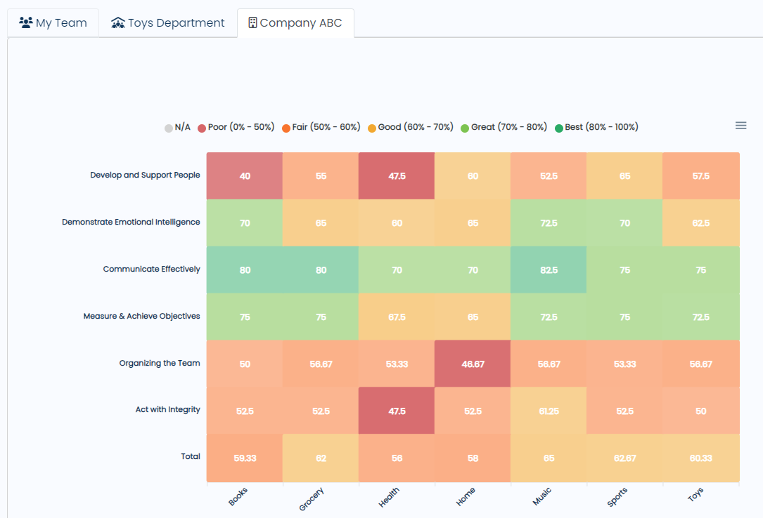
Response Rate by Department by Competencies
Date Range: XX/ XX/XXXX – XX/XX/XXXX
Time Period: X months
  Top Departments:
  Music
  Grocery
  What are these teams doing to achieve high participation?
  Lagging Departments:
  Health
  Home
View the Heat Map and select the attribute of choice (department, location, role, age, tenure etc.).
Reminder: Engage360 will not display any demographic data that may indicate any response to a specific individual. If data does not appear, it is because the anonymity threshold was not met to protect small groupings of employees.

Slide 20
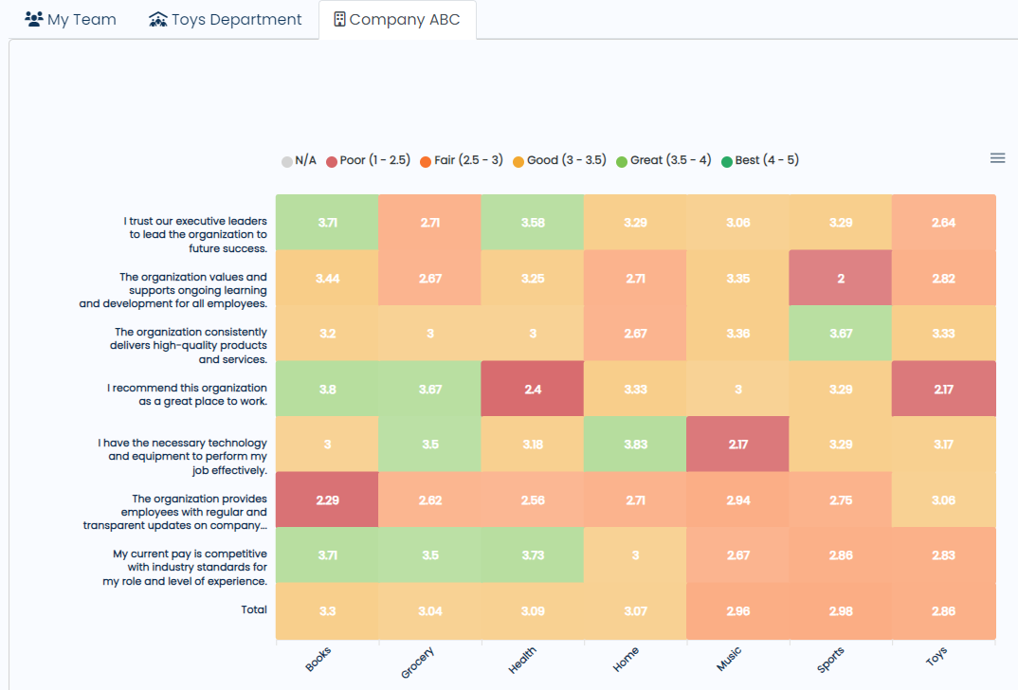
Organization Index by Department by Questions
Date Range: XX/ XX/XXXX – XX/XX/XXXX
Time Period: X months
  Top Departments:
  Books
  Health
  What are these teams doing to achieve high engagement scores?
  Lagging Departments:
  Health
  Home
View the Heat Map and select the attribute of choice (department, location, role, age, tenure etc.).
Reminder: Engage360 will not display any demographic data that may indicate any response to a specific individual. If data does not appear, it is because the anonymity threshold was not met to protect small groupings of employees.

Slide 21
Open Discussion

Slide 22
Section 2:
Share with Managers
Notes:
The slides in section two are intended to be additional reports that should ONLY be shared with managers (with access to the portal; team size 5+) on your team.

Slide 23
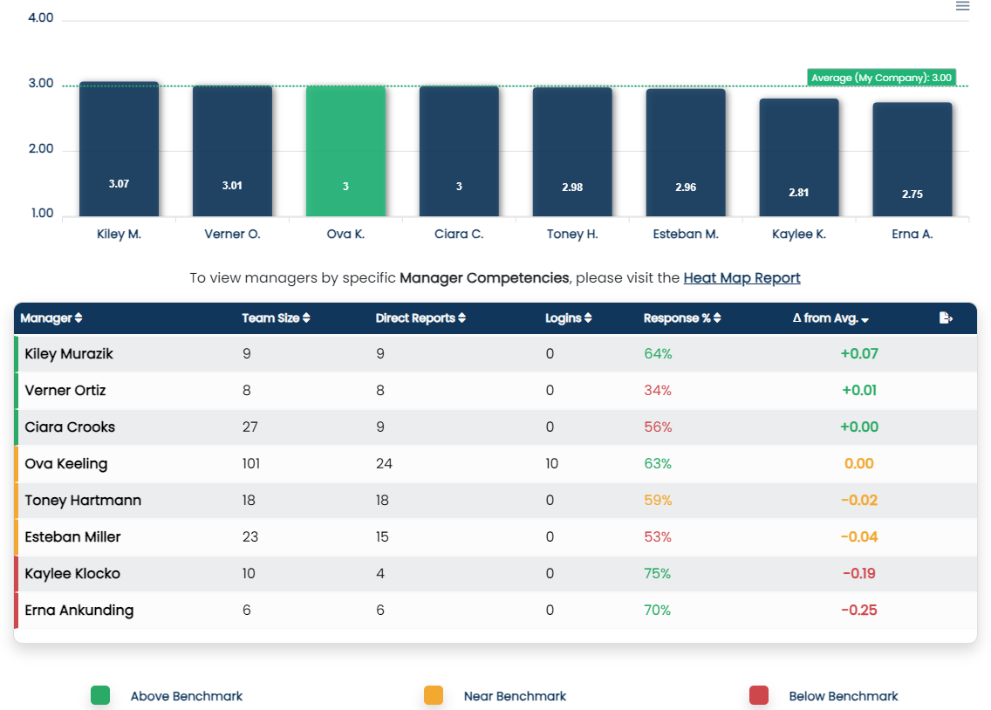
management Score Card
Date Range: XX/ XX/XXXX – XX/XX/XXXX
Our Average Index – 3.0
  Highest Score – 3.07
  Lowest Score – 2.75
Our Goal – 3.20
  Push goal – 3.40
Simply download charts from manager portal (myengage360.com) and paste above.
Go to Home page to view charts.
Also, feel free to share the reporting dashboard live with your team!
Notes:
Example Script for Managers of Managers to Broader Team (Department/Division):

Slide 24
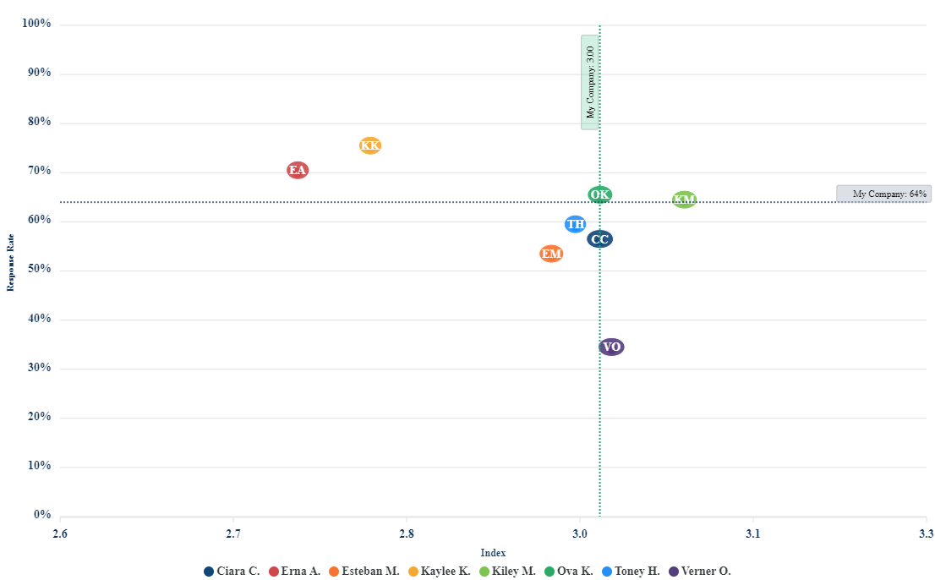
Manager scatter plot
Date Range: XX/ XX/XXXX – XX/XX/XXXX
Average Response Rate – 64%
  Highest Score – 75%
  Lowest Score – 34%
Our Goal – 68%
  Push goal – 70%
Notes:
Example Script for Managers of Managers to Broader Team (Department/Division):

Slide 25
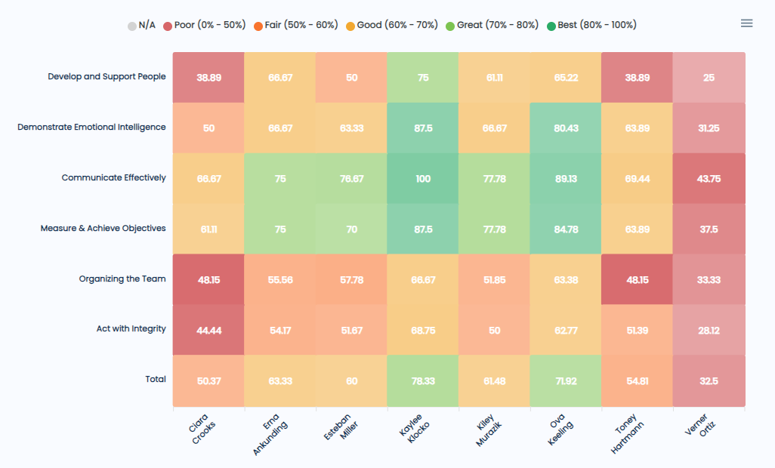
Response Rate by Leaders
Date Range: XX/ XX/XXXX – XX/XX/XXXX
Time Period: X months
  Top Leaders:
  Kaylee Klocko
  Ova Keeling
  What are these people doing to achieve high response rates?
View the Heat Map and select the attribute of choice (department, location, role, age, tenure, etc.).
Reminder: Engage360 will not display any demographic data that may indicate any response to a specific individual. If data does not appear, it is because the anonymity threshold was not met to protect small groupings of employees.

Slide 26
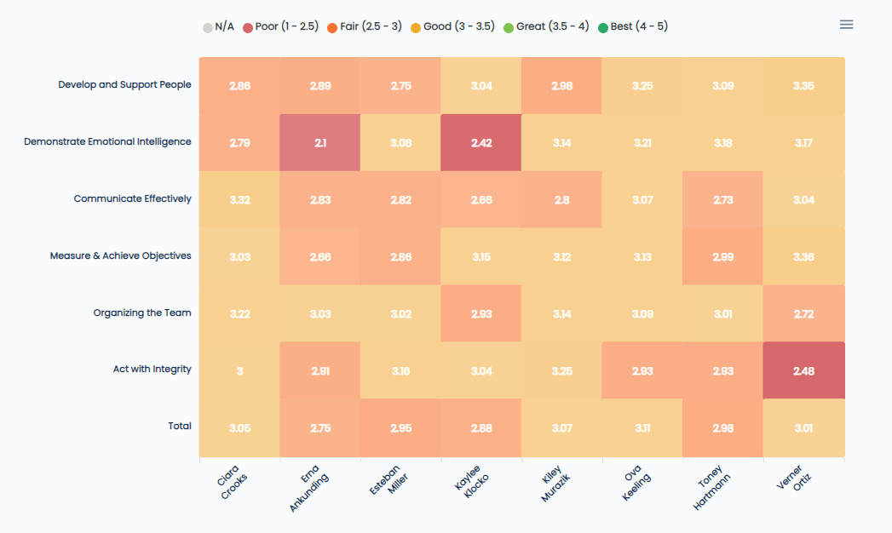
Manager Index by Leaders
Date Range: XX/ XX/XXXX – XX/XX/XXXX
Time Period: X months
  Top Leaders:
  Ova Keeling
  Kiley Murazik
  What are these people doing to achieve high engagement scores?
View the Heat Map and select the attribute of choice (department, location, role, age, tenure, etc.).
Reminder: Engage360 will not display any demographic data that may indicate any response to a specific individual. If data does not appear, it is because the anonymity threshold was not met to protect small groupings of employees.

Slide 27
Open Discussion

Slide 28
Appendix

Slide 29

Best Practices for Leaders of Leaders
Encourage maintenance of a high response rate goal
  Acknowledge teams with great participation
  Support managers to increase participation when needed
  Review Engage360 dashboard results consistently
  Recommend a minimum of once per week
  Communicate macro level results on a regular cadence
  Recommend a minimum of monthly intervals to delivering brief updates
  More in-dept review of information should be shared quarterly
  Address negative results as they arise
  Plan interventions to encourage and support growth of your managers
  Identify barriers and collaborate to create an action plan that is easy to incorporate into manager’s regular routine
  Create time and safe spaces to learn more about leaders
  Consider team and individual activities or discussions
  Focus on strengths while thinking about how improvements can be made in other leadership areas
When results are shared with everyone, response rates and scores increase.
Notes:
Share with your leaders what support they can expect to receive from upper management.
Notes from meeting on 1/9/23:
Standard Reports – 1 first 30 days, 60 days,
Participation % report
Easy to remind people to use it
Reporting and Candance fit into the usage cadence … click the button to produce a manager comparison.
Cadence of discussion at a team level, at divisions level – Get issues on the table.

Slide 30
A Deeper Dive: Sub-Competencies of Effectiveness
Manager Competencies | Organizational Competencies
Act with Integrity Trustworthy & Honest Responsible & Accountable Respectful & Ethical | Culture, Purpose, and Belonging Mission & Vision Communication Connection & Inclusion
Organize the Team Defined Roles & Responsibilities Inclusive Team Dynamics Manage Workloads & Efficiencies | Safety, Technology and Environment Safety Technology, Tools, & Resources Workspace & Environment
Communicate Effectively Feedback & Motivation Recognition & Appreciation Active Listening | Compensation and Benefits Salary & Wages Benefits & Time Off Health & Wellness
Measure and Achieve Objectives Set Objectives Define Actions Review Results | Executive Leadership Trustworthy & Transparent Effective Decision Making Agile & Adaptable
Develop and Support People Coaching Training Relationship Building | Employee Growth Culture of Learning Career Paths Performance Management
Demonstrate Emotional Intelligence Self-Awareness & Self-Management Empathy Social Skills | Products and Services Quality & Innovation Organization Reputation Financial Stability & Future Outlook

